Slide 1
Conference Registration
Calculating Registration Fees for a Conference

Slide 2
Group 12 Members
Kirtan Sukhadiya – 1222983
Abhijeet Singh - 1207508

Slide 3

Introduction
This presentation outlines the javaFX application that calculates registration fees for a conference including general and student pricing, optional dinners, and workshops.

Slide 4
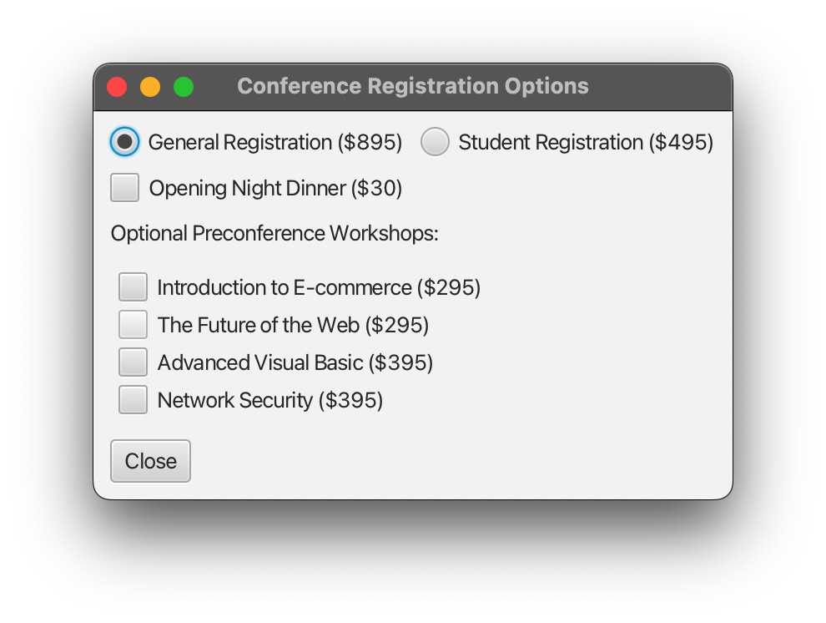
01
Registration Fees

Slide 5
Pseudocode
Start Program
Create window with title "Conference Registration Options"
Add radio buttons for registration type
Add checkbox for optional dinner (disabled initially)
Add checkboxes for workshops (disabled initially)
Enable checkboxes when a registration option is selected
Create "Close" button to calculate total and display in a new window
Show main window
End Program

Slide 6

General Registration Fee
The standard registration fee for attending the conference is set at $895 per person. This covers all main conference activities, materials, and access to networking opportunities.

Slide 7
Student Registration Fee
The special registration fee for students is priced at $495 per person. This discounted rate is aimed at encouraging student participation and engagement in the conference.

Slide 8
Optional Dinner Fee
The optional opening night dinner is available at an additional cost of $30 per person. This dinner includes a keynote speech and provides a great opportunity for networking and socializing before the conference begins.

Slide 9
02
Workshops

Slide 10

Introduction to E-commerce
This workshop, priced at $295, covers the basics of e-commerce including key strategies and tools for launching an online business.

Slide 11
The Future of the Web
Also priced at $295, this workshop delves into upcoming trends and technologies that will shape the future of the web, particularly in terms of user experience and design.

Slide 12
Advanced Visual Basic
The ‘Advanced Visual Basic’ workshop is designed for developers who want to deepen their knowledge of Visual Basic programming. Priced at $395, this session covers advanced techniques, best practices, and real-world applications to enhance software development skills.

Slide 13
Network Security
This advanced workshop, offered at $395, focuses on essential network security techniques that professionals need to protect data and systems from cyber threats.

Slide 14
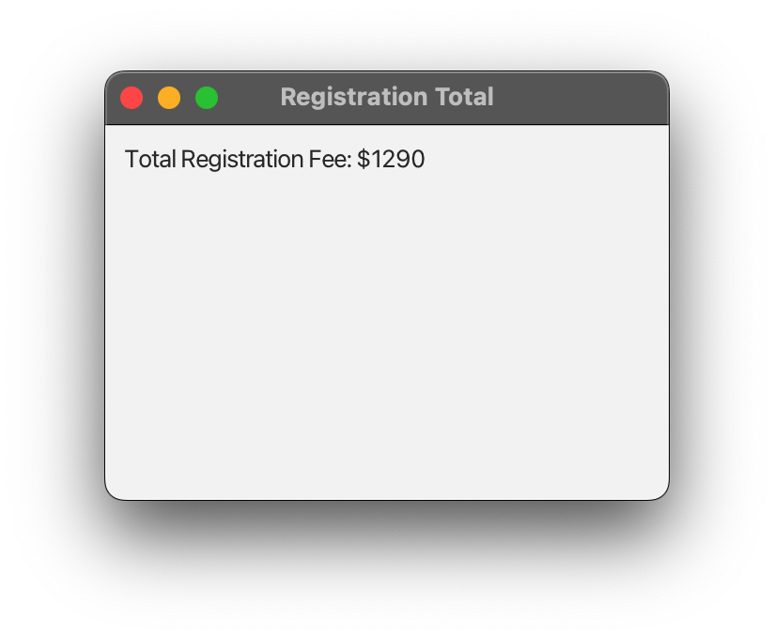
Total Fees Window

Slide 15
What is radio button?
A RadioButton in JavaFX is a UI component that allows users to select one option from a group of choices.
Only one radio button can be selected within a ToggleGroup.
If a radio button is selected, selecting another one in the same group deselects the previous one.
It is commonly used in forms and user selections.

Slide 16
Code:
Imports:-
import javafx.application.Application; import javafx.geometry.Insets; import javafx.scene.Scene; import javafx.scene.control.*; import javafx.scene.layout.HBox; import javafx.scene.layout.VBox; import javafx.stage.Stage;

Slide 17
public class FinalProject extends Application { @Override public void start(Stage primaryStage) { primaryStage.setTitle("Conference Registration Options"); VBox mainLayout = new VBox(10); mainLayout.setPadding(new Insets(10)); // Registration Type Radio Buttons ToggleGroup registrationGroup = new ToggleGroup(); RadioButton generalRadio = new RadioButton("General Registration ($895)"); RadioButton studentRadio = new RadioButton("Student Registration ($495)"); generalRadio.setToggleGroup(registrationGroup); studentRadio.setToggleGroup(registrationGroup); HBox registrationBox = new HBox(10, generalRadio, studentRadio); mainLayout.getChildren().add(registrationBox); // Optional Dinner CheckBox CheckBox dinnerCheckbox = new CheckBox("Opening Night Dinner ($30)"); dinnerCheckbox.setDisable(true); mainLayout.getChildren().add(dinnerCheckbox);

Slide 18
// Workshops CheckBoxes Label workshopLabel = new Label("Optional Preconference Workshops:"); mainLayout.getChildren().add(workshopLabel); CheckBox workshop1 = new CheckBox("Introduction to E-commerce ($295)"); CheckBox workshop2 = new CheckBox("The Future of the Web ($295)"); CheckBox workshop3 = new CheckBox("Advanced Visual Basic ($395)"); CheckBox workshop4 = new CheckBox("Network Security ($395)"); VBox workshopsBox = new VBox(5, workshop1, workshop2, workshop3, workshop4); workshopsBox.setPadding(new Insets(5)); mainLayout.getChildren().add(workshopsBox); // Disable workshops and dinner initially workshop1.setDisable(true); workshop2.setDisable(true); workshop3.setDisable(true); workshop4.setDisable(true); // Enable optional features when registration is selected registrationGroup.selectedToggleProperty().addListener((observable, oldValue, newValue) -> { boolean registrationSelected = (newValue != null); dinnerCheckbox.setDisable(!registrationSelected); workshop1.setDisable(!registrationSelected); workshop2.setDisable(!registrationSelected); workshop3.setDisable(!registrationSelected); workshop4.setDisable(!registrationSelected); }); // Close Button Button closeButton = new Button("Close"); closeButton.setOnAction(e -> { int total = calculateTotal(generalRadio, studentRadio, dinnerCheckbox, workshop1, workshop2, workshop3, workshop4); primaryStage.close();

Slide 19
// Display total in new window Stage totalStage = new Stage(); VBox totalLayout = new VBox(10); totalLayout.setPadding(new Insets(10)); totalLayout.getChildren().add(new Label("Total Registration Fee: $" + total)); Scene totalScene = new Scene(totalLayout, 300, 200); totalStage.setScene(totalScene); totalStage.setTitle("Registration Total"); totalStage.show(); }); mainLayout.getChildren().add(closeButton); Scene scene = new Scene(mainLayout); primaryStage.setScene(scene); primaryStage.show(); }

Slide 20
Calculate Total:
private int calculateTotal(RadioButton general, RadioButton student, CheckBox dinner, CheckBox w1, CheckBox w2, CheckBox w3, CheckBox w4) { int total = 0; if (general.isSelected()) { total += 895; } else if (student.isSelected()) { total += 495; } if (dinner.isSelected()) { total += 30; } if (w1.isSelected()) total += 295; if (w2.isSelected()) total += 295; if (w3.isSelected()) total += 395; if (w4.isSelected()) total += 395; return total; } public static void main(String[] args) { launch(args); } }

Slide 21

Conclusions
The JavaFX application allows participants to easily calculate their registration fees, including options for dinner and workshops, ensuring they can customize their conference experience.

Slide 22
Thank you!
Do you have any questions?

